Slide 1

COVIDaily
XXX Program
Snake Coders
Lucas Falivene Muhammad Bin Oiad Fabio Beltran

Slide 2
AGENDA
Scope
Potential Users
Methods
Libraries Used
Python Features Used
API with Demo
Web Scraping with Demo
Datasets with Demo
Notes:
The 3 methods for information gathering required

Slide 3
SCOPE
This program aims to utilize multiple live data feeds about COIVD-19 pandemic to provide the following updates:
The number of cases in US counties
Travel information by PA Department of Health
General information from CDC
Number of cases worldwide
Notes:
Use of multiple real time information sources for decision making, showing:

Slide 4
POTENTIAL USERS
This program aims to get live data feeds about COVID-19 that could serve:
General users
PA residents
US residents
Government agencies
Hospitals
Notes:
Potential users of this information are:

Slide 5
METHODS
The program uses the following methods to get COVID-19 details:
API: Statistics in the world and the US
Web Scraping: Info for travelers (PA Gov) and FAQ from CDC site.
Datasets: Statistics of active cases in each country in the world

Slide 6
LIBRARIES USED
The following Python libraries were used:
urllib.request
pandas
numpy
matplotlib.pyplot
re
sqlite3
BeautifulSoup
datetime

Slide 7
PYTHON FEATURES USED
The following Python features were used:
API responses processing and storage
Scraping and processing of web information
Database creation, connection and update
Dataframes and pandas functions
Regex expressions
Graphs creation and storage
CSV creation, processing, and storage
Notes:
Mention 3 - 6 only

Slide 8

API OBJECTIVE
Obtain quick real time data from API
Obtain real time data for US counties (with graphs)
Compare US counties data (with graphs)
Store results in a sqlite database
API Used: https://covid-19-statistics.p.rapidapi.com/reports
Information Sources: Johns Hopkins Coronavirus Resource Center

Slide 9
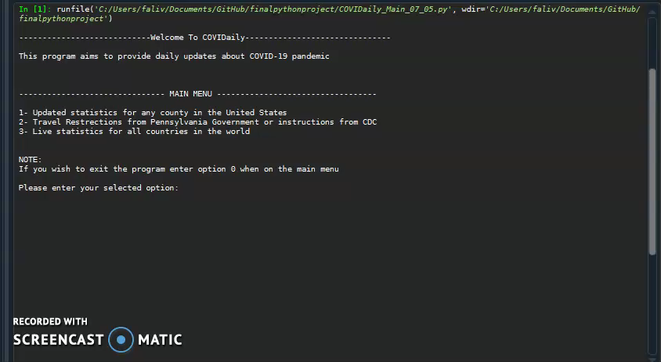
API (Demo)

Slide 10

WEB SCRAPING OBJECTIVE
Scrap the Travelers Info site from PA Department of Health and get relevant information to answer travelers questions.
Scrap Frequently Asked Questions page from the CDC site so that the user can find answers to FAQ by navigating the menu.
Both scrapping functions return nested dictionaries with the scrapped information.
Information Sources: PA health site and CDC

Slide 11
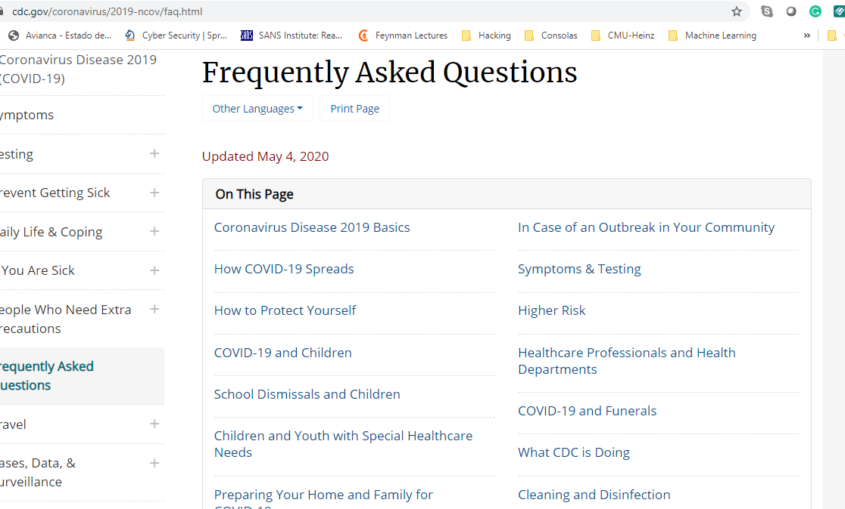
WEB SCRAPING (CDC)

Slide 12
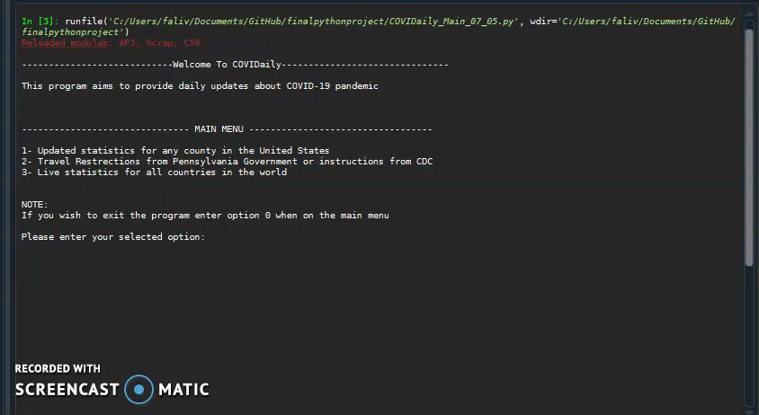
WEB SCRAPING (Demo)

Slide 13

DATASETS OBJECTIVE
Three datasets for confirmed, deaths and recovered COVID-19 cases for every country in the world
The code will provide the following:
Calculate the number of active cases in each country
Plot the curve of active cases since January 22nd 2020
Create a SQLite DB
Information Sources: Compiled by Johns Hopkins University Center for Systems Science and Engineering (JHU CSSE) using WHO, China CDC...etc.

Slide 14
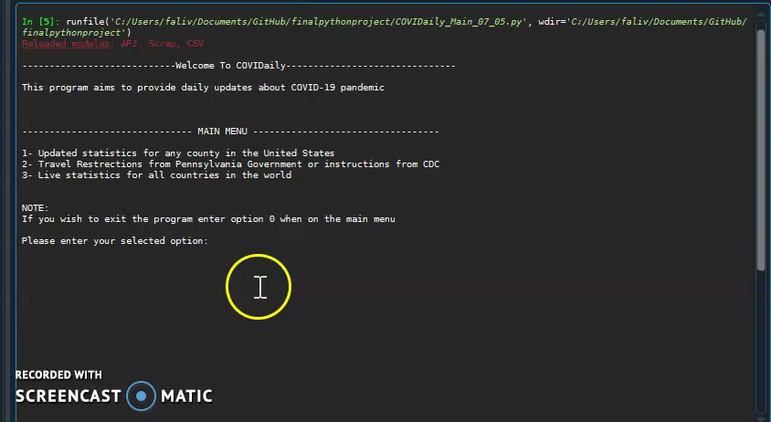
DATASETS (Demo)

Slide 15

Thank you

